Slide 1
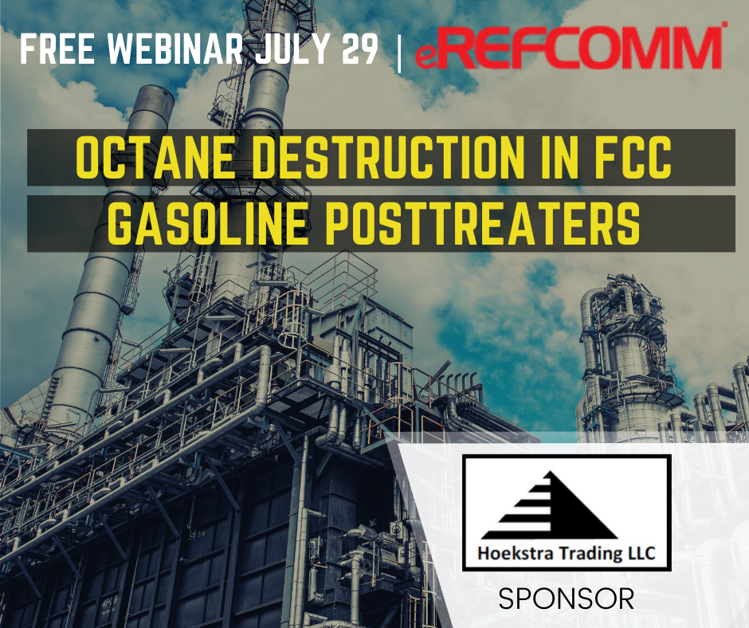
Notes:
Thanks to everyone for joining today and thanks to Becky Peterson and REFCOMM for providing this platform for us to discuss Octane destruction in FCC Gasoline posttreaters

Slide 2
Octane destruction in FCC gasoline desulfurizers
George Hoekstra
george.hoekstra@hoekstratrading.com
+1 630 330-8159
Notes:
I’m George Hoekstra, my company sponsors multi-client research projects in refining technology. We do full-blown research projects that include:

Slide 3
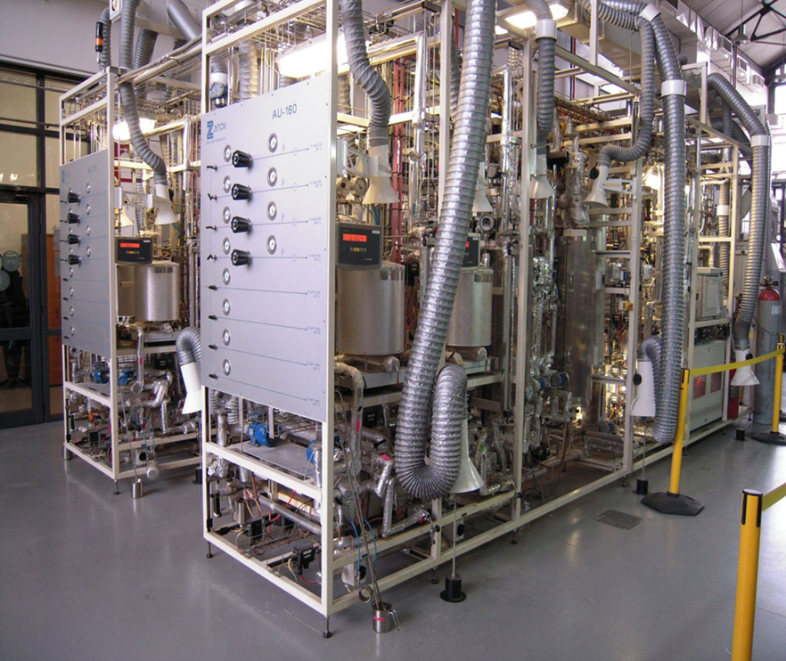
Pilot plant testing
C Solutions LTD.
Thessaloniki, Greece
Notes:
Pilot plant testing. And these are the pilot plants we use for hydroprocessing work, they are owned and run by C Solutions LTD in Thessaloniki, Greece, and I say with full confidence that C Solutions is the best place to do independent pilot plant testing, anywhere in the world today.

Slide 4
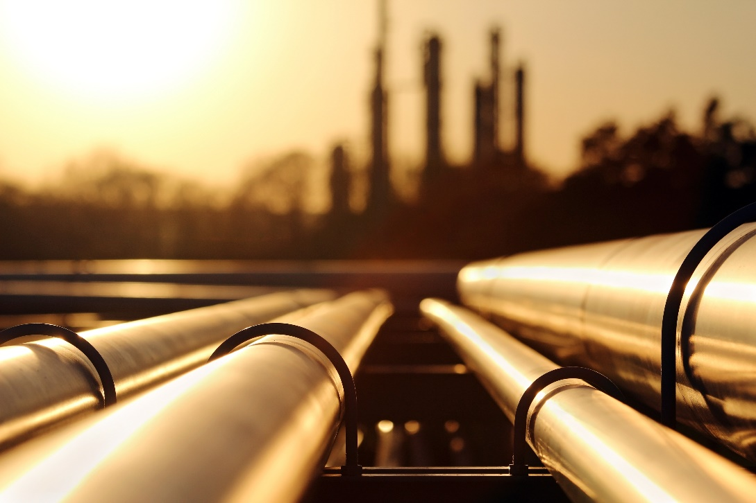
Field testing
Notes:
Our projects also include field testing to measure commercial unit performance and I will talk about this today,

Slide 5
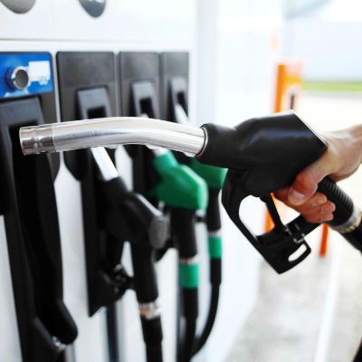
Market analysis
Notes:
And market analysis which includes the regulatory, economic, and business aspects that affect financial performance

Slide 6
Hoekstra Research Reports
Report 6
Report 7
Report 8
Notes:
Our projects work on an annual cycle. Each year, we do a well-defined project and issue an annual report in November. Annual Reports 6, 7, and 8 cover our 3-year program on gasoline desulfurization for Tier 3 gasoline. Report 6 covers the pilot plant work. Report 7 focuses on field testing. And Report 8 focuses on the market research and business strategy aspects. Our annual projects cost $350,000 per year, most of that is for generating new data in the pilot plant, field tests, and analytical testing. Because these are multi-client projects, the cost per client is only a fraction of the total cost. All our reports are available for purchase by anyone, at any time.

Slide 7
Dozens of attachments
Notes:
Our reports include dozens of attachments like these, 10’s of millions of dollars worth of the best published research on the topic. In the case of gasoline desulfurization and Tier 3, we found, bought, studied, and applied a wealth of available research. Some of these attachments are hidden gems. They are included as attachments to our reports so you can read them and become a true expert on that year’s topic.

Slide 8
The Tier 3 standard
Mandates 10 ppm annual average sulfur limit
Enacted in 2014
Phased-in 2017-2020
Notes:
The Tier 3 standard mandates a 10 ppm average annual sulfur limit on gasoline in the United States. It was enacted in 2014 and phased in from 2017 to 2020.

Slide 9
Topics for today
Tier 3 implementation
Octane destruction
Q&A, discussion
Notes:
Topics for today are Tier 3 implementation and octane destruction, and we will have Q&A and discussion on what interests you. And I encourage you at any time to type in your questions into the NEED INSTRUCTIONS

Slide 10
Tier 3 implementation
Is the industry ready?
What’s the problem?
What’s going to happen?
Notes:
Tier 3 implementation. Is the industry ready, what’s the problem, and what’s going to happen?

Slide 11
Tier 3 implementation
Is the industry ready? NO
METRIC | EXPECTED 2014 | ACTUAL 2020 | PREDICTED 2023
Notes:
Is the industry ready? I say no. But this is a minority opinion. The industry consensus says yes. I will present some evidence here to support my contrarian view, in the form of four metrics.

Slide 12
Tier 3 implementation
Is the industry ready? NO
METRIC | EXPECTED 2014 | ACTUAL 2020 | PREDICTED 2023
CAPITAL | $3 billion | 0 | > 0
Notes:
First, capital investment for Tier 3. In 2014, it was expected that $3 billion dollars would be invested in FCC feed pretreaters and FCC gasoline desulfurizers in the United States. But when we look at our FCC trains today and compare them to 2014, we see no net change. There were a few Tier 3 projects but with other changes the net effect is zero. I predict that some of the investment that was expected will occur in the future.

Slide 13
Tier 3 implementation
Is the industry ready? NO
METRIC | EXPECTED 2014 | ACTUAL 2020 | PREDICTED 2023
CAPITAL | $3 billion | 0 | > 0
COMPLIANCE | Early | Late | Late
Notes:
Compliance can be measured by the average sulfur in the US gasoline pool. The industry expectation was for early compliance, meaning the pool would be at 10 ppm S well before the full requirement hit in 2020. Actually, compliance is late. The latest value, reported by EPA two weeks ago, was 17.5 ppm, which is a long way from 10. And I predict that when we reach 2023 and look back, we will say compliance was late.

Slide 14
Tier 3 implementation
Is the industry ready? NO
METRIC | EXPECTED 2014 | ACTUAL 2020 | PREDICTED 2023
CAPITAL | $3 billion | 0 | > 0
COMPLIANCE | Early | Late | Late
COST | 0.5 AKI octane | 2.5 AKI | 2.5 AKI
Notes:
We can measure the cost of Tier 3 gasoline by the amount of octane that is lost in gasoline desulfurizers when refineries make necessary adjustments to make a 10 ppm average gasoline pool. In 2014, that was expected to be 0.5 AKI octane loss, AKI is anti-knock index which is the octane measure we are familiar with in the US. I believe the actual number is 2.5 AKI, five times higher than expected, and I predict that is where we will be in 2023.

Slide 15
Tier 3 implementation
Is the industry ready? NO
METRIC | EXPECTED 2014 | ACTUAL 2020 | PREDICTED 2023
CAPITAL | $3 billion | 0 | > 0
COMPLIANCE | Early | Late | Late
COST | 0.5 AKI octane | 2.5 AKI | 2.5 AKI
CREDITS | Ample supply | Meager supply | Tight supply
Notes:
A fourth metric is the supply of Tier 3 sulfur credits. The 2014 expectation was that there would be an ample supply of Tier 3 credits by now, because of early compliance. In fact, there is a meager supply of Tier 3 credits today, and I predict it will remain tight until 2023.

Slide 16
Tier 3 implementation
Is the industry ready? NO
METRIC | EXPECTED 2014 | ACTUAL 2020 | PREDICTED 2023
CAPITAL | $3 billion | 0 | > 0
COMPLIANCE | Early | Late | Late
COST | 0.5 AKI | 2.5 AKI | 2.5 AKI
CREDITS | Ample supply | Meager supply | Tight supply
$ billions / y in
octane
destruction
Notes:
Among these factors, my focus for today is the cost factor. I believe Tier 3 will cause $ billions per year in unexpected octane destruction and I will focus on that in this this talk. But first, I WENT THROUGH THIS TABLE QUICKLY without covering any detail, and I would like to get your input and have some discussion on it so I’m going to ask here, IF YOU HAVE QUESTIONS OR COMMENTS OR INPUT ABOUT THIS TABLE PLEASE ENTER THEM NOW, ESPECIALLY ABOUT THE CAPITAL, COMPLIANCE, OR CREDITS, AND WE WILL ADDRESS THEM WHEN IM DONE PRESENTING.

Slide 17
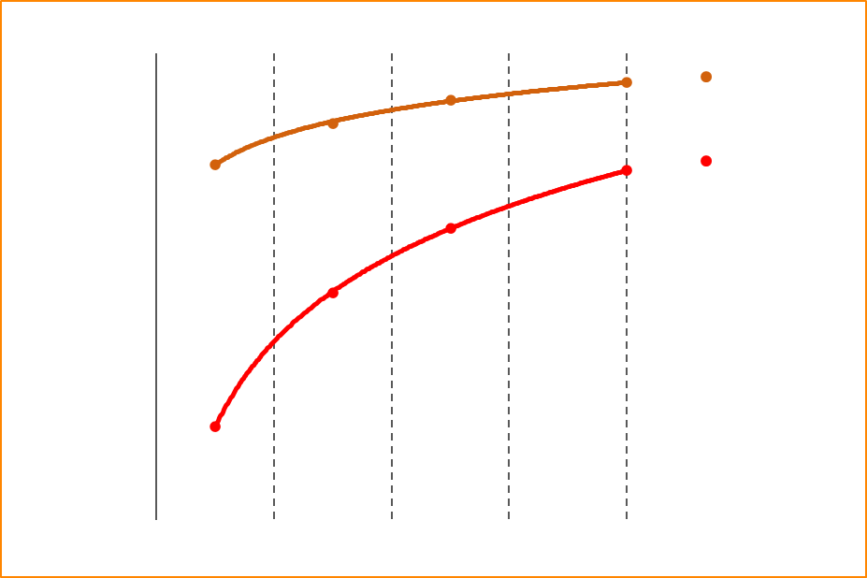
Tier 3 implementation
Is the industry ready? NO
What’s the problem? OCTANE
Notes:
As I see it, the problem is octane. This is a chart of octane loss versus product sulfur for a gasoline desulfurizer. To understand this chart we want to look at it moving from right to left. As we move from right to left, we are increasing severity of desulfurization to drive the product sulfur down, and the curves show we lose more octane. The lower the product sulfur, the more the octane loss. The orange curve we call the ultimate curve because it represents about the best you can do, which is also what the industry has been expecting. The red curve is actual data from a field test on a commercial unit. This chart shows the Octane problem and I will cover it more in a minute.

Slide 18
Tier 3 implementation
Is the industry ready? NO
What’s the problem? OCTANE
What’s going to happen? ADAPTATION
  Purchase alkylate
  Purchase other blend stocks
  Purchase sulfur credits
  Downgrade FCC yields
  Downgrade reformer yields
  Downgrade gasoline streams
  Restrict gasoline end point
  Restrict FCC feedstocks
  Restrict black oil recycle
  Forego premium sales
= Profit
Notes:
Given the octane problem, what is going to happen? In a word, adaptation. Refiners will find ways to make things work. This means adjusting operations to mitigate octane loss, or cope with it, or make up for it, or do without it. ----BUILD----Here are some adaptive steps that are being taken today as US refineries adjust to make 10 ppm gasoline. They involve purchases, downgrades, restrictions on operations, and foregoing sales of premium gasoline -----BUILD----- These adaptations are costly and will substantially affect refining profits.

Slide 19
Tier 3 implementation - poll question
Is your refinery making 10 ppm sulfur gasoline today?
  yes
  no
  don’t know
Notes:
But here I will pause for a poll question. Is your refinery making 10 ppm sulfur gasoline today? Please enter your response and we’ll see the results come up as you respond.

Slide 20
Topics for today
Tier 3 implementation status
Octane destruction
Q&A, discussion
Notes:
Now I will go deeper into the problem of octane destruction, showing more evidence about my claim on the octane problem, and this part will be a bit more technical, but I think will be understandable to everyone if I keep your attention.

Slide 21
Gasoline desulfurizer black box
desulfurization
and
olefin saturation
(destroys octane)
Full-range FCC gasoline
Desulfurized FCC gasoline
Notes:
Gasoline desulfurizers come in different forms, but we can look at them as a black box like this, we feed a full-range FCC gasoline and produce desulfurized FCC gasoline that goes to the blend pool. Two main reactions go on inside, they are desulfurization, and olefin saturation which is an inevitable side reaction that destroys octane. Octane is destroyed because olefins in the feed are much higher octane than the alkanes produced when they are saturated.

Slide 22
Gasoline desulfurizer black box
desulfurization
and
olefin saturation
(destroys octane)
Full-range FCC gasoline
__ ppm total S
__ octane
__ bromine number
Desulfurized FCC gasoline
__ ppm total S
__ octane
__ bromine number
Notes:
To measure performance, we typically measure the ppm total sulfur in the feed and product, the octane number, and the bromine number which is an indicator of the olefinicity of the stream.

Slide 23
Hoekstra pilot plant and field tests
desulfurization
and
olefin saturation
(= octane destruction)
Full-range FCC gasoline
__ ppm total S
__ octane
__ blood test
__ sulfur speciation
Desulfurized FCC gasoline
__ ppm total S
__ octane
__ blood test
__ sulfur speciation
Notes:
In our work, we omit the bromine number and use instead a detailed hydrocarbon type analysis that we call the blood test. The blood test gives very detailed data on the molecular composition of the stream. We also do sulfur speciation, which gives the detail on the sulfur compounds in the stream.

Slide 24
Field test - example
 |  | Four reactor temperatures
 |  | 1 cold | 2 cool | 3 warm | 4 hot
 | Feed | product 1 | product 2 | product 3 | product 4
Sulfur |  |  |  |  | <10 ppm
Octane
Blood test
Sulfur speciation
Notes:
So here is the layout for a good field test that you could do in a 3 day period to show exactly what is happening in your gasoline desulfurizer. Looking first at the columns, you change reactor temperature over 4 levels, shown here as cold, cool, warm, and hot. At each temperature, you let the product sulfur line out then sample the product and measure sulfur, octane, the blood test and sulfur speciation.

Slide 25
Performance curve
∆ RON vs. product sulfur from a field test
actual
copyright 2019 george.hoekstra@hoekstratrading.com
Notes:
You chart your performance curve, octane loss versus product sulfur, showing how, as you raise severity and reduce product sulfur, you lose more octane. The red curve here was measured in a field test. The orange curve is the ultimate curve which is also what the industry is expecting as typical. But the orange curve is not typical; it is like the best-case scenario. Our data shows US gasoline desulfurizers are much more clustered around the red curve. This difference, between the orange and red curves, between expected and actual,

Slide 26
Performance curve
∆ RON vs. product sulfur from a field test
actual
copyright 2019 george.hoekstra@hoekstratrading.com
Notes:
is unexpected octane destruction that is very well documented in our reports from many field tests, and pilot plant tests, and this is the biggest reason I disagree with the consensus on industry readiness.

Slide 27
Blood test
Olefins by carbon number distribution from a field test
Notes:
The blood test gives a chart of wt% olefins by carbon number in the feed and the products. In this example from a field test, the dark red is the feed and the bright red is the product. The shape of the curves shows the olefins are in the carbon number 5 to 9 range with the peak at carbon number 7 showing that C7 olefins are most abundant in this case. This chart displays the reason for octane destruction which is the destruction of olefins.

Slide 28
Blood test
Olefins by carbon number distribution from a field test
Octane destruction
51% olefin conversion
7 RON octane loss
Notes:
The space between the feed and product curves shows the olefin conversion that is causing the octane destruction. In this field test, 51% of the FCC olefins were converted to alkanes causing 7 RON octane loss. The blood test shows precisely the chemistry causing octane destruction. Most of the US octane supply is produced in cat crackers. When you destroy half your FCC gasoline olefins, that destroy a lot of your refinery’s octane-barrel production.

Slide 29
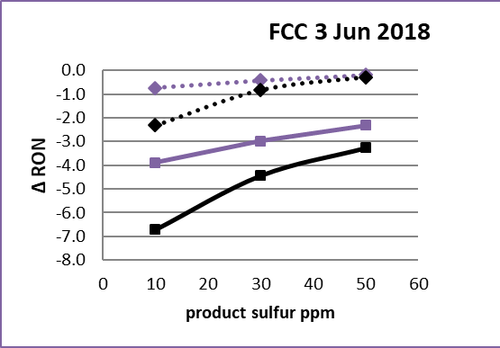
Modern tools shine the light on octane destruction
Performance curve model
Blood test
Notes:
Modern tools shine the light on octane destruction. With performance curve and blood test data from a field test, it was easy for this refinery to quantify the dollar impact of that octane destruction and convincingly justify some capital investment to reduce the octane destruction. When you shine a light on what is happening in your unit, significant improvements can almost always be achieved, often with little or no capital investment. Running a good field test and using these tools makes sense In the Tier 3 era. You should not accept your gasoline desulfurizer being a black box. These 21st century tools will show exactly what is happening so you can make the right decisions to get sulfur out and save octane. These 2 diagrams are pictures from our performance curve model which is a spreadsheet that produces the charts I’ve been showing and many more that enable you to see what is happening and accurately predict how your performance curve will move with changes you can make to the process. All you need is a blood test on your feed and this spreadsheet.

Slide 30
Another field test example
copyright 2019 george.hoekstra@hoekstratrading.com
Notes:
Here is another field test example. You will notice this red curve has seven data points, that’s because this test plan was expanded, from 4 temperatures to 7. The measured red curve was below what we predicted before the test, however during the test, the sulfur speciation data revealed something that was not known before. The refinery team made an adjustment that caused the subsequent data, not shown here, to fall right along the predicted curve. The field test data revealed an unknown factor that enabled them to move the curve up by 2 RON immediately. Octane is extremely valuable today in the market. Moving your curve up by even a little is usually worth $10s of thousands of dollars per day.

Slide 31
Octane destruction - poll question
Is your refinery tight on octane when running at full utilization?
  yes
  no
  don’t know
Notes:
Here is another poll question – Is your refinery tight on octane when running at full utilization?

Slide 32
Pop quiz
How many different compounds are in gasoline?
Notes:
And here is a pop quiz. How many different compounds are in gasoline. Just think for a minute what you would guess. And this is a good question for your high school chemistry students at home to bring to their chemistry teachers and see if their teacher knows the answer.

Slide 33
Answer
550 compounds in raw cat gasoline
450 compounds in desulfurized gasoline
759 compounds total in our database
Notes:
The answer is 550. That is in a raw cat gasoline. There are 450 compounds in desulfurized gasoline. Wwe have found a total of 759 different compounds in the many gasolines we have analyzed. The blood test quantifies the amount of each one. Now in this final segment of this presentation I’m going to go one step deeper into our performance curve model and talk about molecular level analysis and calculating octane loss

Slide 34
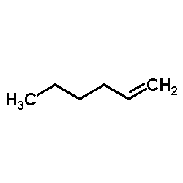
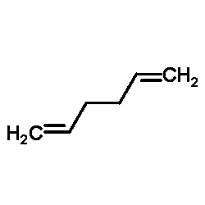
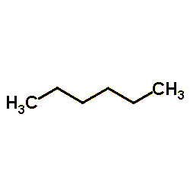
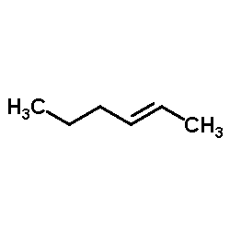
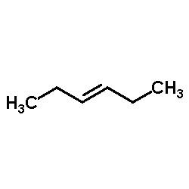
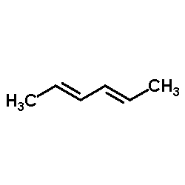
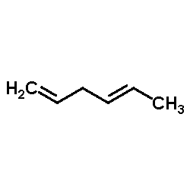
Olefins reaction paths
An example – making normal hexane
hexene-1
1-5-hexadiene
hexene-2
(cis and trans)
n-hexane
hexene-3
(cis and trans)
1-4-hexadiene
cis and trans
methylpentadiene
Notes:
This chart shows, inside the boxes, 7 compounds found in gasoline. The largest box is n-hexane or normal hexane which is a fully-saturated compound, also called an alkane. The other six compounds are olefins that have the same linear structure as n-hexane, but they are unsaturated meaning they have one or more double bonds. These are the particular olefins that, when saturated, become n-hexane. This is a reaction path diagram for saturation of all olefins that become normal hexane when saturated. In our performance curve model, EVERY olefin has been placed on one and only one reaction path diagram, according to what alkane it forms when saturated. And the blood test tells us not only how much of each compound is in your feed, but also how much is in your product after reaction. Why is this molecular detail useful?

Slide 35
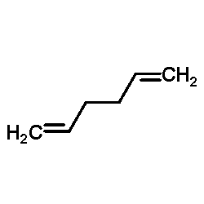
Calculating octane loss
An example – making normal hexane
hexene-1
1-5-hexadiene
n-hexane
blending octane value is negative
hexene-2
(cis and trans)
hexene-3
(cis and trans)
1-4-hexadiene
cis and trans
methylpentadiene
Notes:
It is useful for calculating octane loss. These unsaturated, linear olefins are great for octane, and the saturated product n-hexane is horrible for octane. In fact, the blending octane value of n-hexane is negative. Our performance curve model contains the best-available octane model to calculate the octane impact of each reaction path. We didn’t develop that octane model, we acquired it, after searching for and evaluating many other octane models. Now here’s my final point about this diagram. Imagine another reaction path, one that produces a branched C6-alkane, from similarly branched olefins. The octane impact of that reaction path is much less than this normal hexane path, because the product, a branched alkane, has a blending octane around 70 instead of negative. So knowing the detailed chemistry of the olefins in the feed is critical for accurate calculation of octane loss, and for knowing how vulnerable a feed is to octane destruction. All this is accounted for directly in the performance curve model.

Slide 36
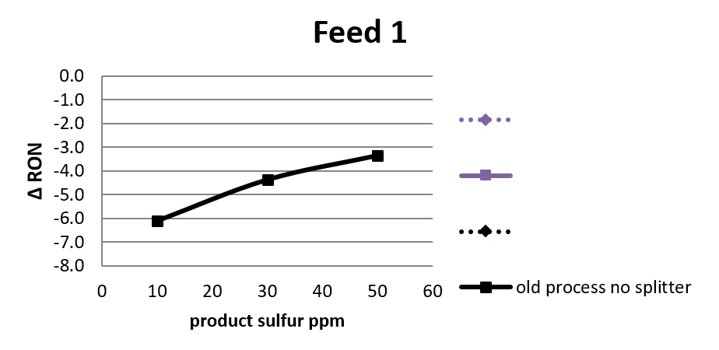
Performance Curve model
Notes:
Different feeds are very different in their vulnerability to octane loss. Once we have analyzed your feed, our Performance Curve model can accurately estimate your performance curve and the effect of operating changes. For example, here is the effect of changing the olefins distribution from Feed 1 to Feed 2 which is less vulnerable to octane loss. If you change crude, or FCC operation, expect your performance curve to move. A common option is to add a splitter that causes the lightest olefins to bypass the desulfurizer. The dashed curve shows that octane benefit. Now we return to the original feed and can see the effect of a splitter on Feed 1. All these changes are easily and accurately calculated by this spreadsheet.

Slide 37
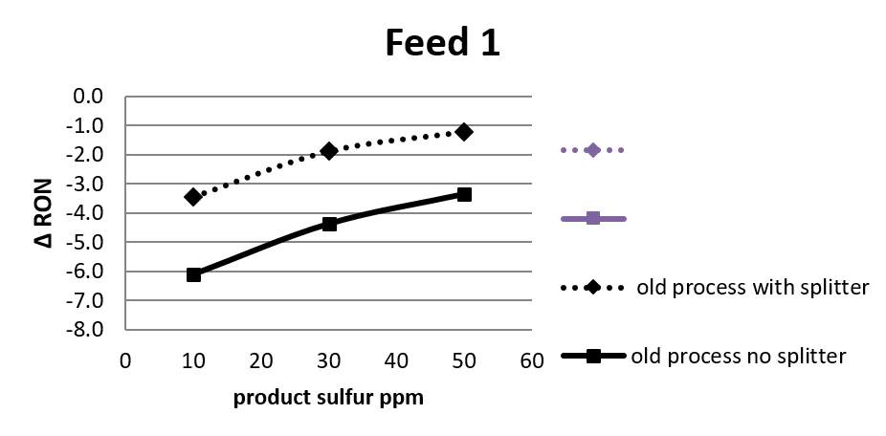
Performance Curve model
Notes:
Now I will remove the splitter and we say what if we could double the selectivity of the process, that is the sulfur/octane selectivity. That might be hard to do in reality but in this spreadsheet, you can set that selectivity and see the effect and it gives the solid purple curve. Now instead of doubling the selectivity, I will set it here to a 40% improvement which is more realistic and can be achieved with a new process that’s available today, that process is offered by Haldor Topsoe. A selectivity improvement means a fundamental improvement in the sulfur/octane reaction selectivity that is caused by a change in the catalyst or the process or the process conditions. And if you used the new Topsoe process with a splitter, here is that combined effect. You can see how much octane that would save.

Slide 38

Performance Curve model
Blood
test
10 numbers
Olefins model
Octane model
Notes:
The performance curve model takes the blood test and reduces it to 10 numbers that pertain to 10 key reaction paths that determine octane loss. These 10 numbers are fed into an olefins model that calculates the changing composition along the reaction paths and an octane model that calculates octane loss from the changing composition. The olefins model and the octane model are, we believe, the best available models for this purpose. The output is delta octane versus product sulfur, which is the performance curve.

Slide 39
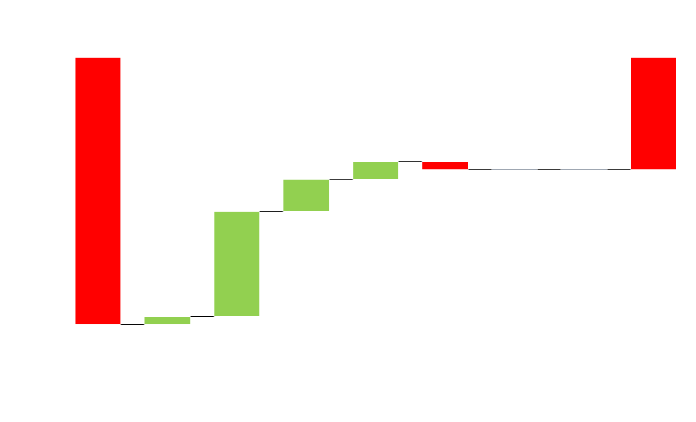
Octane destruction accounting
Notes:
The performance curve model also produces this chart that accounts for octane changes by hydrocarbon type. In this field test example, looking at the left-most red bar, the loss of olefins accounted for 17.3 RON octane loss, Those olefins became normal paraffins, iso-paraffins, and naphthenes, whose octane partly offset the loss from olefins. There are smaller octane effects involving reaction of aromatics, unknowns, C14+ compounds and oxygenates, and the total octane impact, on the far right, adds up to 7.3 RON octane loss.

Slide 40
Performance curve model
Is included with purchase of Research Report 7
All Research Reports include 4 blood tests
All Research Reports include 6 months unlimited support
Notes:
This performance curve model is included with purchase of Research Report 7, so you will have it for your own use. It is not an annual license it is a one-time cost; it is included with the purchase of Report 7 which is the middle of the three reports I showed earlier. All our research reports also include 4 blood tests, so you just send us samples of your feed and product streams and we will get the analysis done and load the model with your own data and you will have all the charts I have shown and more. All our research reports also include 6 months of unlimited support by phone and E-mail. I hope you see how valuable this can be in the Tier 3 world, to be able to see, understand, and control what is happening in your gasoline desulfurizer instead of it being a black box to you. This is something that was seen by some very astute people in my client group back in 2014. They saw their gasoline desulfurizer as an outlier in being a black box process. The cat feed hydrotreater and the FCC unit are not black boxes, we have very detailed knowledge and data and understanding of the reactions happening in them and we use that knowledge all the time to optimize performance. Why is the gasoline desulfurizer a black box to us, where we can't know what’s happening inside the process, and can't use that knowledge to optimize the unit’s performance? That insight was the beginning of our work on this.

Slide 41
Performance curve model
A tool for decision-making
Tier 3 strategy
Capital investments
Licensor and catalyst selection
Process design
Feeds
Cut points
Notes:
The performance curve model is a 21st century tool that has been used since 2016 for decision making on
BUILD Tier 3 strategy, Capital investments, licensor and catalyst selection, process design, feeds and cut points,
If you have a gasoline desulfurizer, your engineers and planners should certainly have this tool! With an analysis of your feeds and this spreadsheet, you will see and understand what is happening in the unit, make accurate performance estimates, and better decisions for Tier 3 gasoline.

Slide 42
Thanks for your attention!
Tier 3 implementation
Octane destruction
Q&A, discussion
Notes:
Thanks for your attention, I am done presenting now and we are open for Q&A and discussion. Please go ahead and enter your questions now.

Slide 43
Q&A, Discussion
  $3 billion capital investment
  Late compliance
  $ billions / year of octane will be destroyed
  Sulfur credits
  Field testing
  Blood test
  Sulfur speciation
  Performance curve model
  Hoekstra Research Reports
  For an offer letter contact George Hoekstra
  George.hoekstra@hoekstratrading.com
  +1 630 330-8159
Notes:
Here is a list of topics I have brought up, please submit any questions or comments or input on any of these and we will address them for the rest of the hour. And if you see a question on the list that you like, press the thumbs up to move it up and we will raise them in order. 1 minute pause. If you want to participate directly by audio just unmute yourself and speak up and hopefully we will hear your voice.

Slide 44
Pulling together knowhow
Refinery technology
Refinery economics
Refinery modeling
Octane technology
Octane economics
Octane modeling
Gasoline marketing
Gasoline regulations
Gasoline credits
Notes:
My focus today was on octane loss in desulfurization which is an aspect of refinery technology.. But our study covered all aspects of the Tier 3 issue from across disciplines as shown on this list. Our reports and assistance will help you with any aspect of this topic.

Slide 45
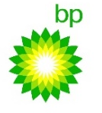





















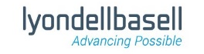
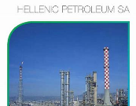




We appreciate our clients!
Notes:
Over ten years, these clients have come to see, and to benefit of sharing results from our multi-client refining technology research projects.

Slide 46
Thanks for your attention!
  George Hoekstra
  George.hoekstra@hoekstratrading.com
  +1 630 330-8159
Notes:
Thanks and have a good day.

Slide 47
Backup slides

Slide 48



Mercaptans and thiophene
__ ppm
__ ppm
__ ppm
__ ppm
700 ppm S
__ ppm

Slide 49




Alkylthiophenes
__ ppm
__ ppm
700 ppm S
__ ppm
__ ppm
__ ppm
__ ppm
__ ppm
__ ppm
__ ppm

Slide 50




Benzothiophenes
700 ppm S
__ ppm
__ ppm
__ ppm
__ ppm
__ ppm
__ ppm
__ ppm
__ ppm

Slide 51
Gasoline sulfur reduction toward 10 ppm has been slow in North America
Gap
Notes:
Gasoline sulfur reduction toward 10 ppm has been slow in North America this is the us average ppm sulfur in gasoline. which has been going down toward 10 ppm as required by EPA’s Tier 3 regulation, in 2020.
This leaves a gap of 14 ppm more sulfur removal to be accomplished, from 24 to 10 ppm, by 2020.
Note that we are now halfway through 2018 which is half way through this time gap, so a lot will be happening in the next 18 months.
That’s the story on sulfur, what’s the story on octane?

Slide 52
The octane/sulfur squeeze
Octane demand
Octane price
Octane supply
PPM sulfur
Gap
Notes:
With increasing octane demand, and increasing octane price, and anticipating a $15 billion/year reduction of refinery octane supply, this is the octane sulfur squeeze.

Slide 53
The octane/sulfur squeeze
Updated
July 17,2019
PPM sulfur
Gap
Notes:
So we see a $15 billion/yr loss of refinery octane supply coming, lets look now at the demand for octane

Slide 54
Fluid cat cracking (FCC) process train
Thanks to John Jechura
Colorado School of Mines
for refinery flowchart
Notes:
The fluid catalytic cracking (FCC) process train is highlighted here in green. Starting at the left, the first green block is the feed hydrotreater which pretreats low value, high sulfur, heavy oil, then the second green block, the fluid cat cracker, or FCC, cracks it to gasoline which is then desulfurized in the third green block, the gasoline desulfurizer. The product, FCC gasoline, is the largest component of the US gasoline pool. It is also the source of almost all the sulfur in the pool. The key to meeting the Tier 3 spec is to reduce the sulfur in this FCC gasoline stream. And the weak link is in this train.

Slide 55
Yellow refinery – no gasoline desulfurizer
Notes:
This train, shown in yellow has no gasoline desulfurizer. I will refer to this as a yellow refinery.

Slide 56
Red refinery – no FCC feed hydrotreater
Notes:
And this FCC train has no feed hydrotreater. I call this a red refinery.

Slide 57
Three categories of FCC refinery
 | Complete FCC train
 | No gasoline desulfurizer
 | No feed hydrotreater
Notes:
So consider three categories of FCC refineries: green, with a complete train, yellow, with no gasoline desulfurizer, and red, with no feed hydrotreater. The point is that green refineries have a huge advantage for making Tier 3 gasoline. In fact, wherever in the world 10 ppm sulfur gasoline is made today, like Europe and California, refineries fall mostly in the green category. The United States will now we be relying heavily on yellow and red refineries. They will have little margin for error. Red refineries especially, have a big disadvantage. They lack the FCC feed hydrotreater which is a high horsepower unit that removes a lot of difficult sulfur from the heavy feed before it is cracked. Without the feed hydrotreater, the red refinery is placing the total Tier 3 load on the gasoline desulfurizer, which is a very low horsepower unit.

Slide 58
Three categories of FCC refinery
 | 40%
 | 20%
 | 40%
Notes:
In 2011, Mathpro did a study on Tier 3 refining economics using their LP model of the US refining system. By Mathpro’s count, in 2011, we were 41% green, 24% yellow, and 35% red.

Slide 59
Gasoline desulfurizer sulfur analysis
Light cat gasoline
Full-range FCC gasoline
700 ppm S
Desulfurized FCC gasoline
7 - 100 ppm S
Heavy cat gasoline

Slide 60

I recommend you should buy our reports on Tier 3 gasoline!
Notes:
I am recommending you should buy one of our reports! It’s a smart thing to do. I suggest the third, most recent report. It’s very easy to join our client group. You just sign a purchase order and we deliver the report at the speed of light. In the past, this kind of research has been very expensive, top secret and proprietary, you could not buy work like this, but now that has changed. Nothing in any of our reports is confidential. You don’t need a lawyer, your standard PO terms and conditions on the internet work fine. Don’t form a committee to decide whether to buy it, that will cost more than the report. Just buy it and use it. It’s very good work on an important topic that costs only a minute’s worth of your annual revenue. That’s my amateur sales pitch. And I will finish by quoting a true professional salesman:

